Slide 1
Blood and Muscle Bioenergetics and Physical Function in Older Adults
Daniel Tyrrell, PhD student
Anthony Molina Laboratory

Slide 2
Physical Ability Predicts Morbidity and Mortality in Older Adults
Physical ability is an indicator of quality of life and a key endpoint in clinical aging research
Among measures of physical function, gait speed predicts morbidity and mortality
Gait speed declines with age

Slide 3
Hypothesis
Age-related bioenergetic decline is related to slow gait speed in older adults

Slide 4
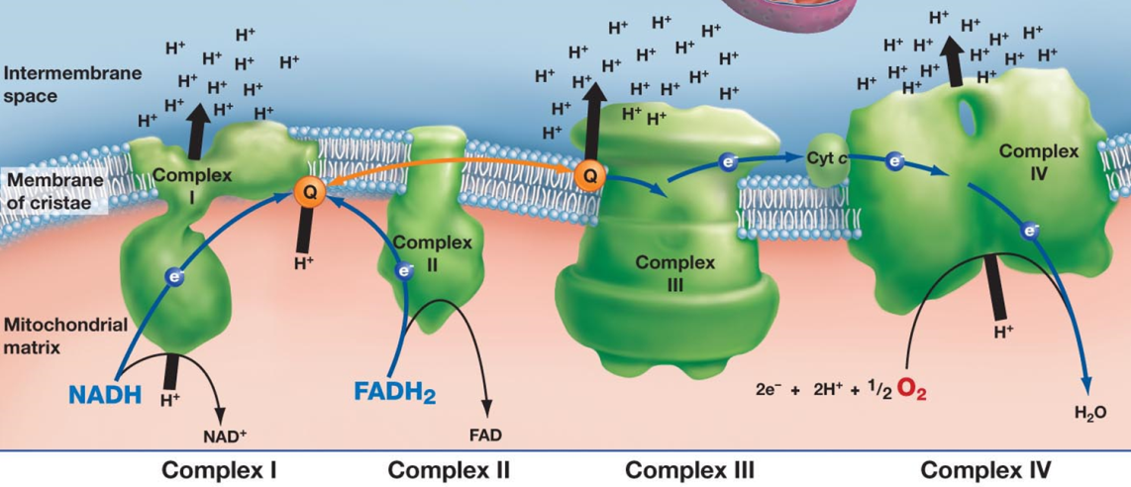
Isolation of Mitochondria from Human Skeletal Muscle
Biopsy Vastus Lateralis
Isolate Mitochondria
Analyze bioenergetics using Seahorse XF-24
Respiratory Control Ratio is the primary outcome

Slide 5
Respirometry of Isolated Mitochondria
Max
(State 3)
ADP
Oligomycin
FCCP
Max
(State 3u)
Antimycin A
State 4o
Non-Mito
Respiration
State 2

Slide 6
Isolated Skeletal Muscle Mitochondrial Bioenergetics Study:
Demographics

Slide 7
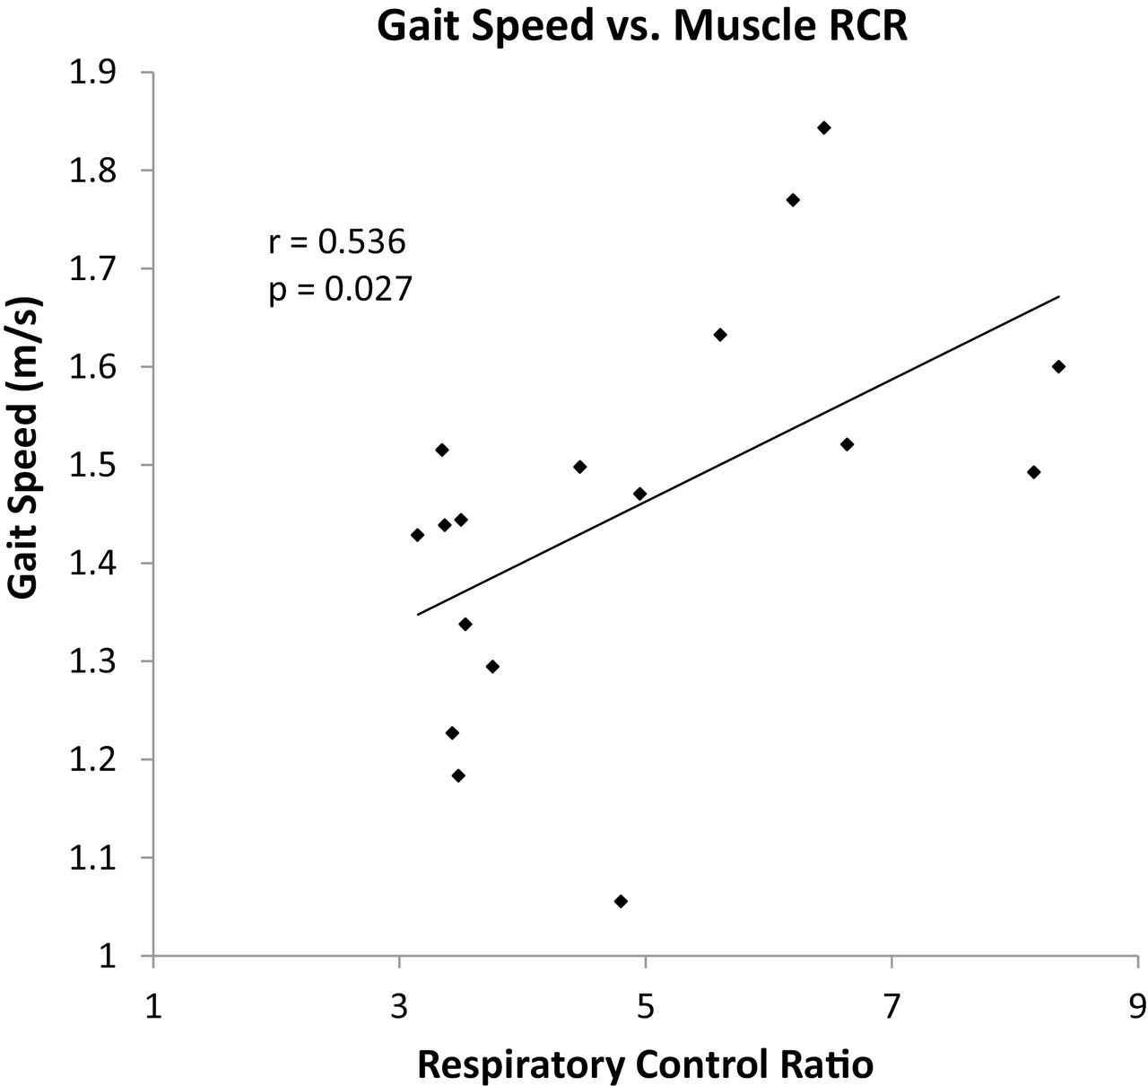
Respiratory Control Ratio is Positively Correlated with Gait Speed

Slide 8
Blood carries immune cells that sense and respond to stress in the body
Bioenergetics are affected by: inflammatory, redox, and metabolic stress
Circulating immune cell bioenergetics may be related to physical ability in aging

Slide 9
Isolation of Peripheral Blood Mononuclear Cells from Whole Blood
Collect Blood in CPT Tube
Isolate PBMCs
Analyze cellular respiration using Seahorse XF-24
Primary Outcomes are: Max, Basal, and Spare
Respiratory Capacity

Slide 10
Whole Cell Respirometry

Slide 11
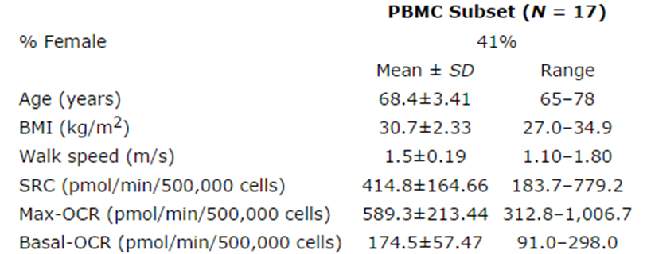
Blood-cell Mitochondrial Bioenergetics Study:
Demographics

Slide 12
Blood-cell Bioenergetics are associated with Gait Speed

Slide 13
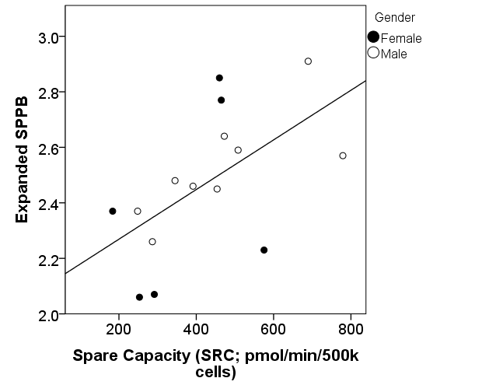
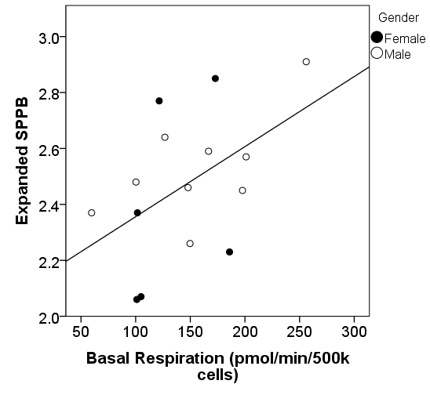
Physical Function measured by Expanded Short Physical Performance Battery is associated with PBMC bioenergetics
 | SRC |  | Max |  | Basal
Correlation | r | p-value | r | p-value | r | p-value
Pearson | 0.59 | 0.02* | 0.58 | 0.02* | 0.50 | 0.06
Partial w/ Age | 0.59 | 0.02* | 0.59 | 0.02* | 0.50 | 0.07
Partial w/ Gender | 0.55 | 0.04* | 0.55 | 0.04* | 0.46 | 0.10
Partial w/ BMI | 0.59 | 0.02* | 0.59 | 0.03* | 0.49 | 0.07

Slide 14
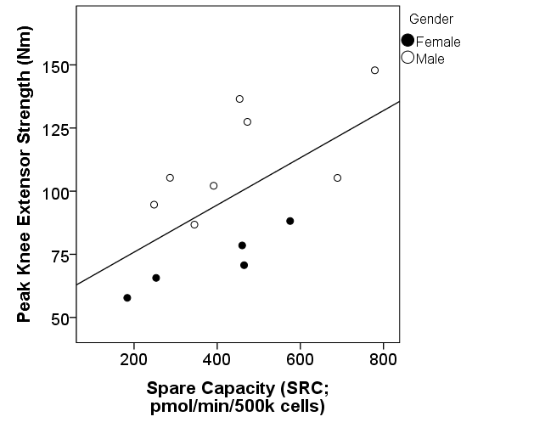
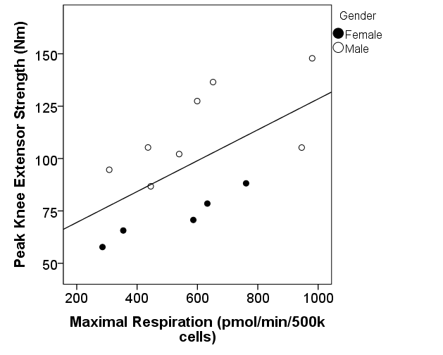
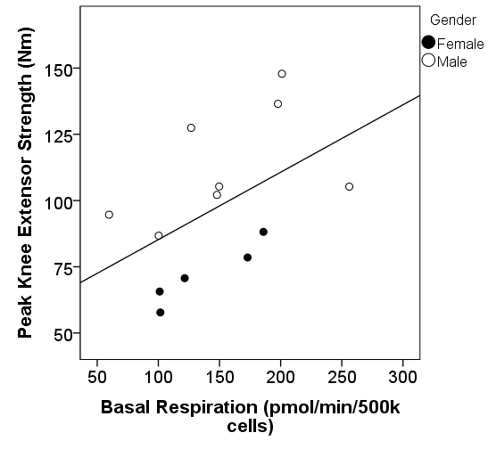
Peak Knee Extensor Strength is associated with PBMC Bioenergetics
 | SRC |  | Max |  | Basal
Correlation | r | p-value | r | p-value | r | p-value
Pearson | 0.60 | 0.03* | 0.60 | 0.03* | 0.50 | 0.08
Partial w/ Age | 0.59 | 0.04* | 0.59 | 0.04* | 0.49 | 0.10
Partial w/ Gender | 0.70 | 0.01* | 0.69 | 0.01* | 0.58 | 0.05*
Partial w/ BMI | 0.59 | 0.04* | 0.60 | 0.04* | 0.53 | 0.07

Slide 15
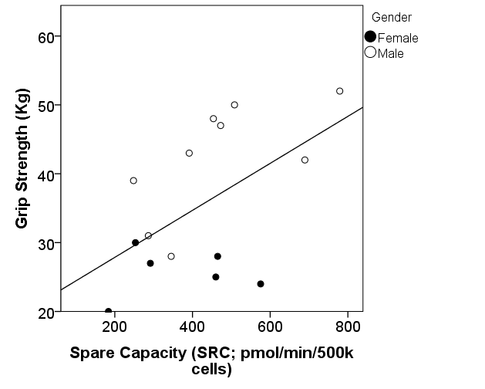
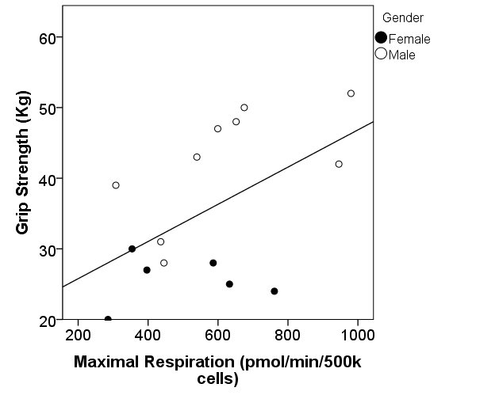
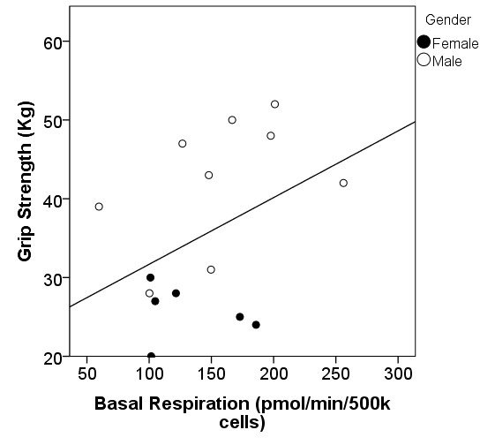
Grip Strength is associated with PBMC Bioenergetics
 | SRC |  | Max |  | Basal
Correlation | r | p-value | r | p-value | r | p-value
Pearson | 0.54 | 0.04* | 0.52 | 0.05* | 0.40 | 0.13
Partial w/ Age | 0.59 | 0.04* | 0.59 | 0.04* | 0.49 | 0.10
Partial w/ Gender | 0.53 | 0.05* | 0.51 | 0.06 | 0.35 | 0.21
Partial w/ BMI | 0.57 | 0.03* | 0.57 | 0.03* | 0.52 | 0.06

Slide 16
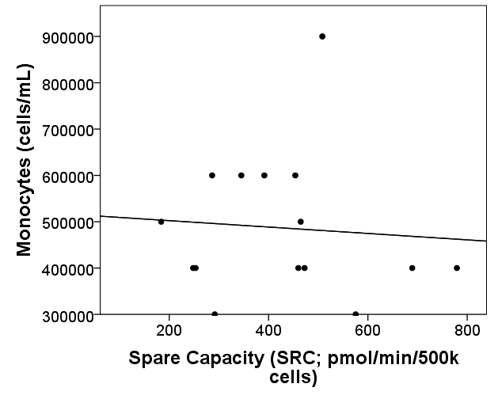
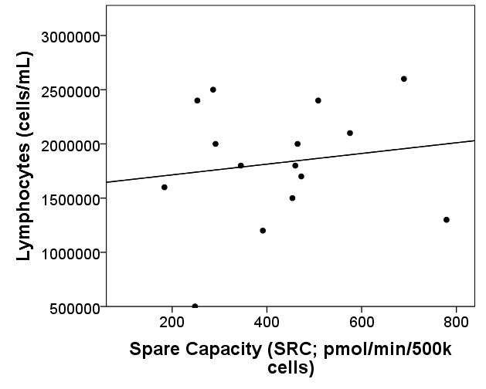
Blood bioenergetic profile is independent of PBMC composition
R=-0.075
p=0.791
R=0.147
p=0.601

Slide 17
Conclusions:
Skeletal Muscle Bioenergetics strongly correlate with 400m Gait Speed
Blood-cell Bioenergetics correlate with 400m Gait Speed, Ex-SPPB, Knee Extensor & Grip Strength
Blood-based Bioenergetics may serve as a biomarker for Systemic Mitochondrial Health

Slide 18
Acknowledgements
Sticht Center on Aging
Molina Lab:
Anthony Molina, PhD
Manish Bharadwaj, PhD
Past members:
Daniel Hurley
Jordan Strober
Cynthia Van Horn, PhD
Nicklas Lab:
Barb Nicklas, PhD
Karin Murphy
John Stone
Heather Gregory
Sticht Center on Aging
Stephen Kritchevsky, PhD
Jeff Williamson, MD
I’M FIT Team:
Mary Lyles, MD
Jamehl Demons, MD
CRU Staff
National Institute on Aging:
R01-AG020583-09
R01-AG020583-09-S1
Gerontological Society of America
Carol Schutz Student Travel Award
Seahorse Bioscience
Seahorse Bioscience Travel Award

